Slide 1
Fundamentals of Thermal Bridging
Educational Overview
Updated July 10, 2018

Slide 3
Learning Objectives
Describe a thermal bridge
Estimate the magnitude of the effect of thermal bridges can have on whole wall performance
Describe quantitatively various mathematical approaches to calculating assembly performance
Explain the pros and cons of various methods

Slide 4
Acknowledgements
This presentation is adapted from a presentation given by Jay Crandell P.E. at the 2018 ASHRAE Annual Conference, June 27, 2018.
The author wishes to acknowledge the following individuals for their contributions (direct or indirect) to the content of this presentation and work on-going within the ASHRAE 90.1 Envelope Subcommittee’s Thermal Bridging Task Group:
  Leonard Sciarra, Gensler, Chair Envelope Subcommittee
  Jonathan Humble, AISI, Chair Thermal Bridging Task Group
  John Hogan, City of Seattle / Consultant
  Patrick Roppel, Morrison Hershfield LTD
  Members of the Thermal Bridging Task Group
Preparation of this presentation was funded by the Foam Sheathing Committee of the American Chemistry Council

Slide 5
Outline
Types of Thermal Bridges & Implications
Design and Mitigation Concepts
Examples of Thermal Bridge Mitigation Strategies
Calculation Methods and Design Data
Design Example
Status of ASHRAE 90.1 Thermal Bridging Work
Conclusions
Bibliography (design resources)

Slide 6
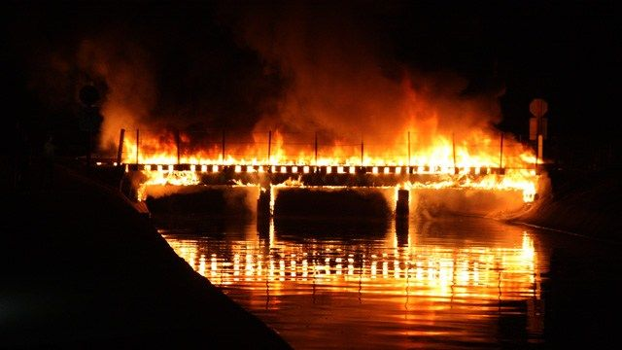
What is a thermal bridge?
Attempting to regulate thermal bridges in buildings can seem to be like “burning bridges”, but a burning bridge is not a thermal bridge.
Source: Steve Dadds; as published in azfamiliy.com by 3TV/CBS 5, posted Aug. 17, 2015.
http://www.azfamily.com/story/29807270/pd-gilbert-railroad-bridge-fire-suspicious

Slide 7
Types of Thermal Bridges
Clear-field thermal bridge
Linear thermal bridge
Point thermal bridge

Slide 8
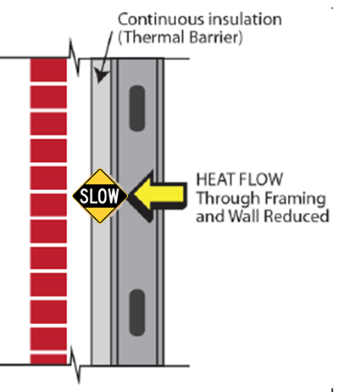
Clear-Field Thermal Bridge
Thermal pathways inherent to a building assembly and its surface area
Generally accounted for in U-factor calculations, R-value prescriptions, and assembly thermal test methods for energy code compliance
Examples: Wood and steel studs and plates (framing), webs of concrete masonry units, etc.
Impact: For example, cavity insulation in steel framing is only ~35-50% effective
  Wall with R-21 cavity insulation has effective R-7.4 to R-9.0 for 16”oc and 24”oc studs

Slide 9
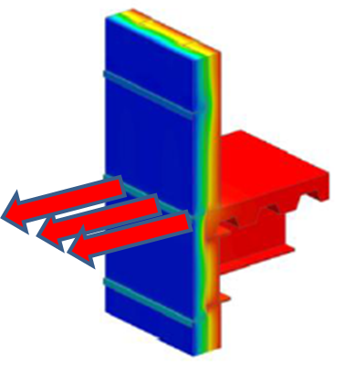
Linear Thermal Bridge
Additional heat flow caused by details that can be defined by a length along the building surface.
  Units for “Psi-factor” (Ψ) – linear thermal transmittance:
  [IP] Btu / hr-ft-ºF
  [SI] W / m-K
Usually associated with the intersection of different assemblies and components.
Generally not accounted for in the clear-field U-factors used for purposes of “compliance” with 90.1 or IECC:
  Exceptions:
  1) F-factors for insulation of slab-on-grade foundation edges
  2) Requirement to model “uninsulated assemblies” in performance/simulation path.
Source: Morrison Hershfield LTD /
ASHRAE RP 1365
Linear Thermal Transmittance

Slide 10
Linear Thermal Bridge
Examples: Slab floor edges, balconies, shelf-angles, corners, parapets, window-wall interface, int/ext wall interface, floor-wall interface, foundation-slab interface, furring penetrating through insulation, columns or beams in the plane of an assembly, etc.
Impact: Depending on quantity and detailing used, these heat flows can account for 20-70% of total opaque envelope heat flow!
  Other consequences include low temperature surfaces (increased condensation, rot, corrosion and mold risk)
Source:
USACE report

Slide 11
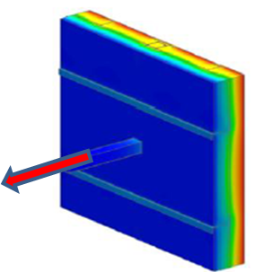
Point Thermal Bridge
Heat flow caused by a thermal bridge that occurs at single element or discrete “point”
  Units for “Chi-factor” (χ) – point thermal transmittance:
  [IP] Btu / hr-ºF
  [SI] W / K
Generally not accounted for in U.S. energy codes and standards
Examples: Pipes, beams, and column penetrations through building envelope
  Fasteners, brackets, ties, etc. also can be treated as point thermal bridges, but are best addressed as part of the assembly U-factor calculation if distributed uniformly and repetitively over area of assembly
Impact: Assembly U-factor increased from 1% to 40% depending on amount of insulation penetrated, size and spacing of penetrations, type of structural substrate, penetrating material conductivity, 3-D geometry, etc.
Point Thermal Transmittance
Source: Morrison Hershfield LTD / ASHRAE RP 1365

Slide 12
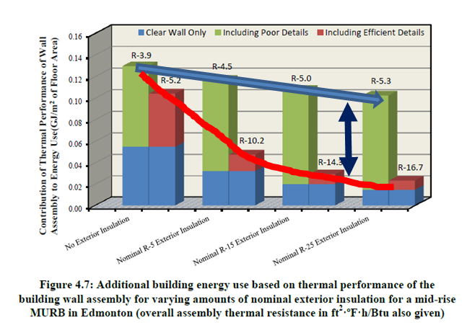
Implications of un-mitigated thermal bridges
Ignoring thermal bridges can result in significantly over-estimated building performance and moisture condensation (corrosion, mold, rot).
Without choosing to mitigate thermal bridge details, the benefit of adding insulation to improve effective R-value of the assembly is severely diminished
CONCLUSION: If you have a leaky bucket, don’t try to fix it by thickening the walls of the bucket – fix the leaks first!
Source: Morrison Hershfield Ltd

Slide 13
Design Concepts for Clear-Field Thermal Bridges
Clear-field thermal bridges generally are required to be accounted for in U-factor calculations or tests for assemblies:
  Refer to ASHRAE 90.1 Appendix A and Handbook of Fundamentals
    Light-frame construction and metal building systems account for thermal bridging caused by framing members within the assemblies
  Some U-factor calculation methods are empirical and include some amount of fastener point thermal bridges; some may include brick ties; some don’t address impact of fasteners at all (cladding, interior finish, exterior sheathing, etc.).
  Can model or test assemblies, but all relevant thermal bridges in the “as-constructed” assembly must be included

Slide 14
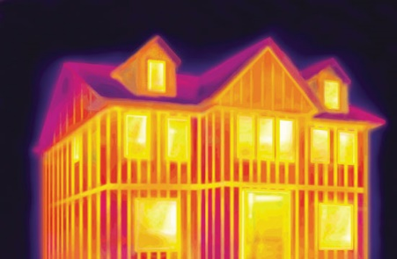
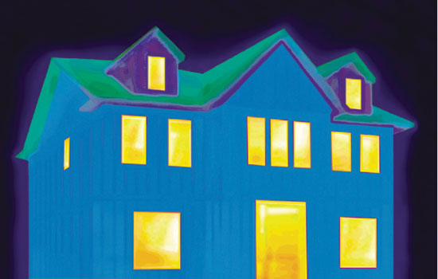
Mitigation Concepts for Clear-Field Thermal Bridges
Some ways to mitigate clear field thermal bridges include:
  Reduce “framing factor” where structurally feasible (wider frame spacing, double stud framing, etc.)
  Use low conductivity structural materials
  Apply continuous insulation over structure/framing members (minimize discontinuity at floor/wall/roof intersections)
  Mount furring over (not through) continuous insulation layer
  Use low conductivity fasteners or devices to attach cladding, furring, etc. to framing (e.g., stainless steel, carbon fiber, etc.)
Before
R-13 batts in cavity between studs
After
R13 + ½” rigid foam continuous insulation over studs
Source: Dryvit/Dow

Slide 15
Design Concepts for Point & Linear Thermal Bridges
Point and linear thermal bridges are not commonly addressed in U.S. practice in applying IECC and ASHRAE 90.1 standard.
  Performance path in 90.1 does require “uninsulated assemblies” to be modeled, but not using Psi-factors (instead a surrogate uninsulated assembly U-factor is applied to the small area of a linear thermal bridge)
  Proposal to address linear and point thermal bridges is being developed and considered by ASHRAE 90.1 SSPC
  Brief treatment is addressed in ASHRAE Handbook of Fundamentals, but without data for Psi-factors
  Various resources are available for Psi- and Chi-factor data to aid in accounting for and mitigating linear and point thermal bridges (SEE BIBLIOGRAPHY)

Slide 16
Mitigation Concepts for Point Thermal Bridges
Some ways to mitigate point thermal bridges include:
Minimize penetrations of high thermal conductivity materials through the building envelope.
Encapsulate the penetrating element with insulation for at least 2 feet inward or outward from the envelope.
Use lower conductivity materials
  Stainless steel
    3x lower thermal conductivity than carbon steel
    5x lower thermal conductivity than aluminum
    More durable (benefit for cladding attachments)
  Various proprietary thermal break materials and devices

Slide 17
Mitigation Concepts for Linear Thermal Bridges
Some ways to mitigate linear thermal bridges include:
  Convert a linear thermal bridge to a series of point thermal bridges to disrupt and minimize heat flow pathway
  Examples:
    Offset brick shelf angle and continuous insulation
    Offset furring (on surface of continuous insulation and fastened through at points)
    Thermally broken or self-supported balconies
    Fenestration interface (alignment with insulation and insulation of exposed rough opening)
    Floor edges (continuous insulation)
    Foundation edges (continuous insulation) – F-factors don’t account for all the options to maximize placement and value of insulation to minimize slab edge heat loss
    Various proprietary structural thermal break devices

Slide 18
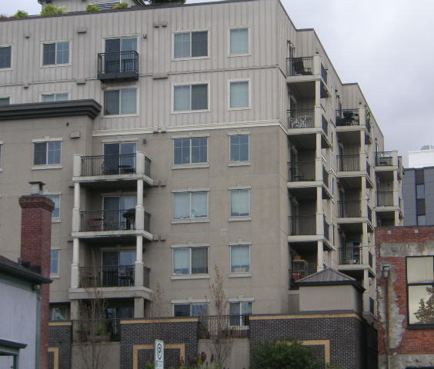
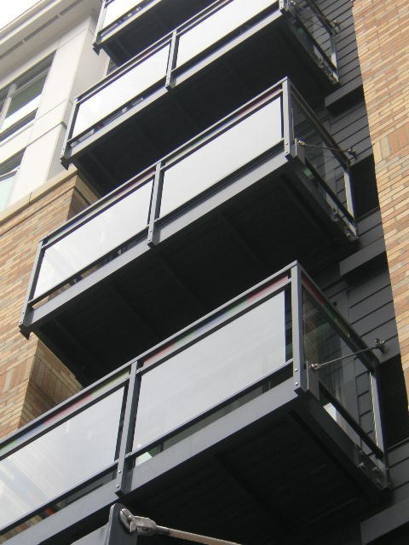
Examples of Mitigated Linear Thermal Bridge (Balconies)
Suspended and separately supported balconies with shear tab or offset shelf-angle point connection to building (photos courtesy of John Hogan)

Slide 19
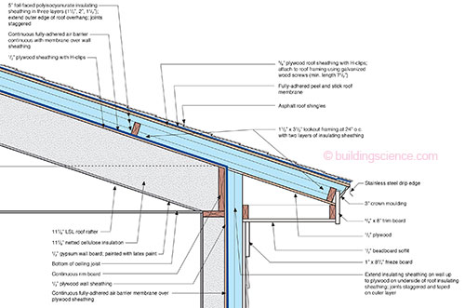
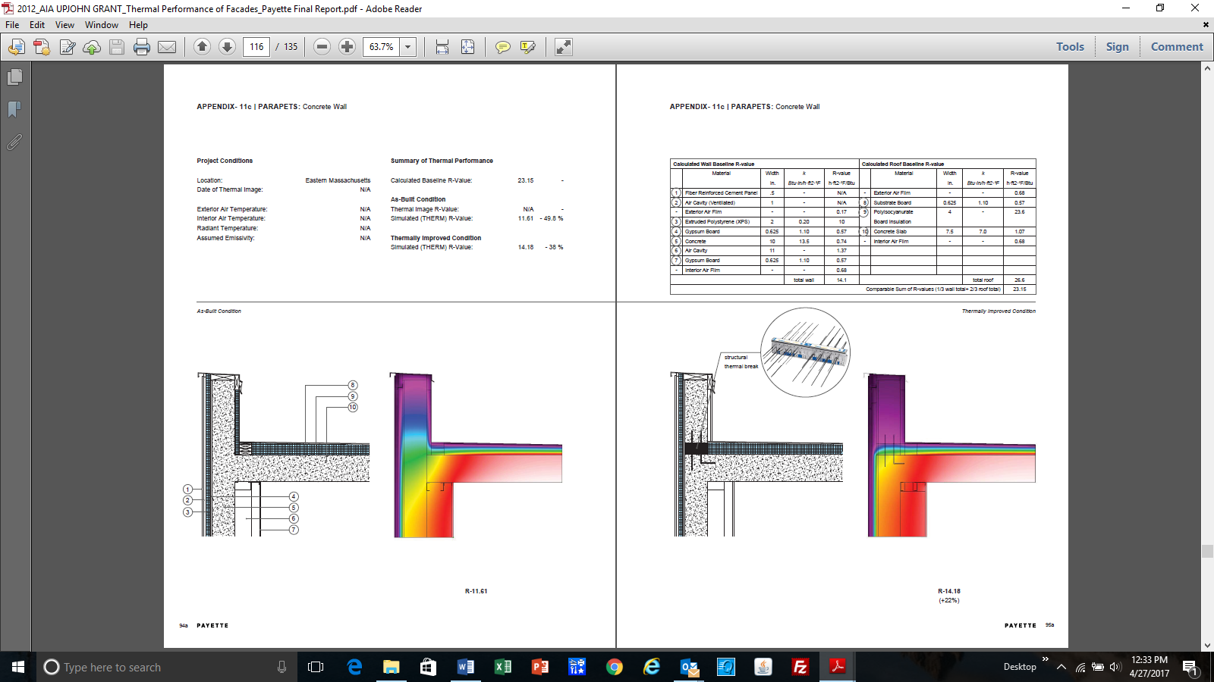
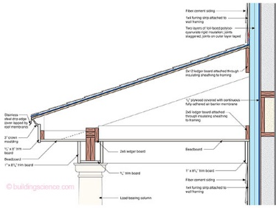
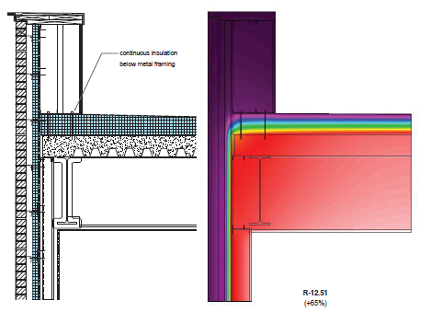
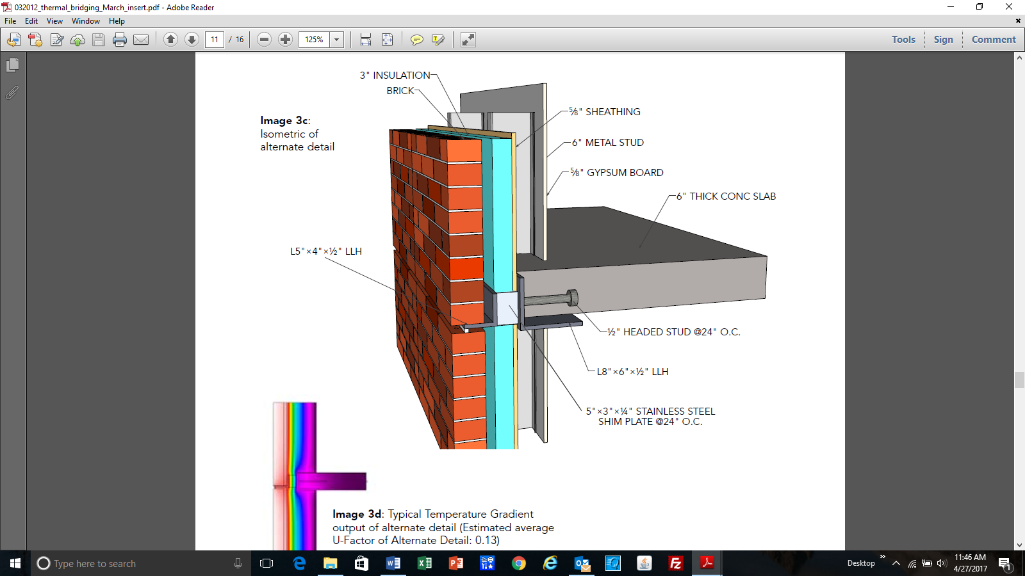
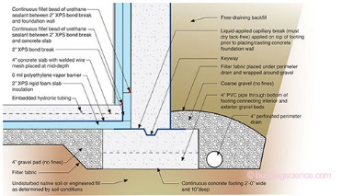
More Examples of Mitigated Linear Thermal Bridges
(non-exhaustive “commodity” details)
INSULATED WINDOW ROUGH OPENING DETAIL
(USACE report)
INSULATED PARAPET DETAILS
(Payette/ AIA report)
Example Details from BSI-081: Zeroing In (J. Lstiburek, Building Science Corp) as used on NIST NZERTF Project
https://buildingscience.com/documents/insights/bsi-081-zeroing-in
OFFSET SHELF ANGLE
(AISC/SEI article)

Slide 20
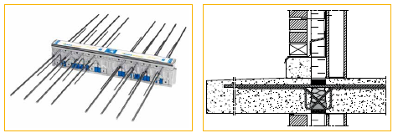
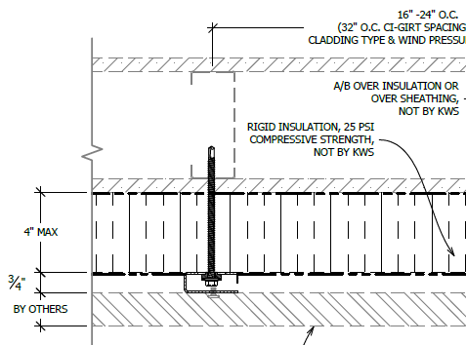
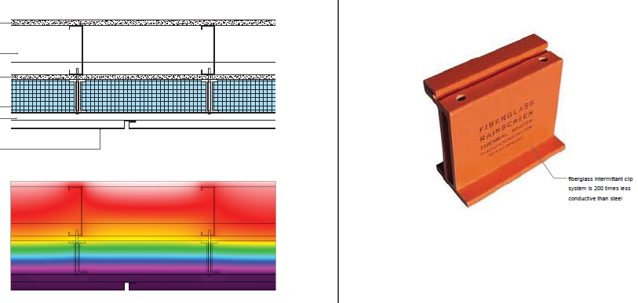

Examples of Proprietary Thermal Bridging Devices
(non-exhaustive “google” search)
Cantilevered Balcony Structural
Thermal Break
Source: www.schock-na.com
Low thermal conductivity furring/cladding/ledger supports
Sources: Payette/AIA report, https://knightwallsystems.com/;
http://www.cascadiawindows.com/products/cascadia-clip , etc.
Structural thermal block for steel beam projections through building envelope
Source: www.schock-na.com

Slide 21

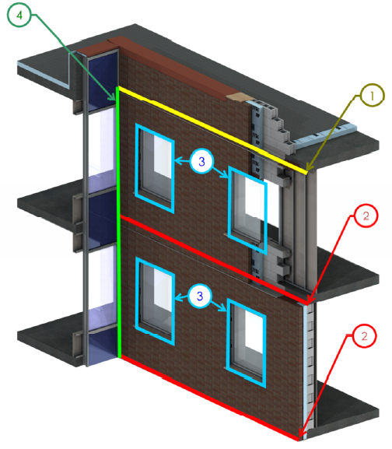
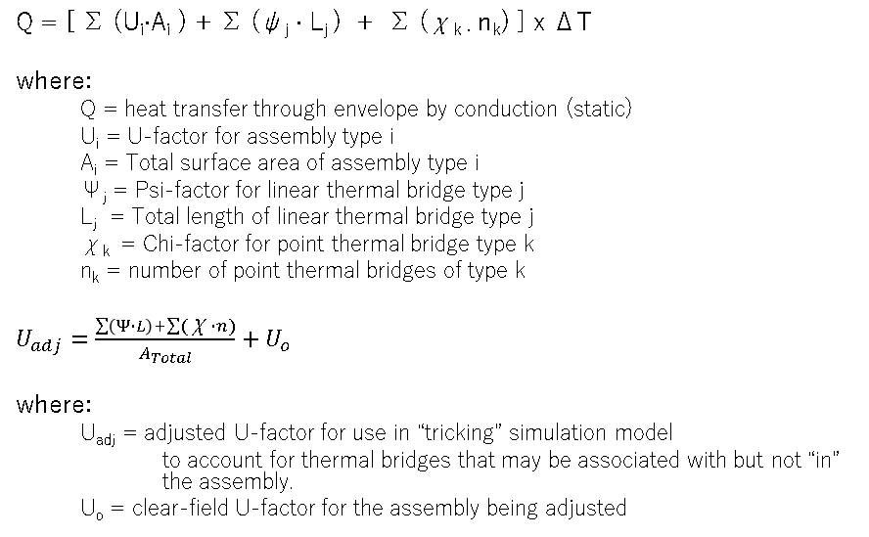
Calculations to Account for Point & Linear Thermal Bridges
Q = [ ∑ (U_{i}∙A_{i} ) + ∑ (ψ_{j} ∙ L_{j} ) + ∑ (χ_{k ∙} n_{k}) ] x ΔT
where:
  Q = heat transfer through envelope by conduction (static)
  U_{i} = U-factor for assembly type i
  A_{i} = Total surface area of assembly type i
  Ψ_{j} = Psi-factor for linear thermal bridge type j
  L_{j} = Total length of linear thermal bridge type j
  χ_{k} = Chi-factor for point thermal bridge type k
  n_{k} = number of point thermal bridges of type k
$U_{adj}=\frac{\sum{\left(Ψ∙L\right)+\sum{(\text{χ}∙n)}}}{A_{Total}}+U_{o}$
where:
  U_{adj} = adjusted U-factor for use in “tricking” simulation model
  to account for thermal bridges that may be associated with but not “in” the assembly.
  U_{o} = clear-field U-factor for the assembly being adjusted
Source: BC Hydro BETB Guide / Morrison Hershfield LTD

Slide 22
Example Design Data
(Psi-factors for floor edges)
Source:
BC Hydro BETB Guide / Morrison Hershfield LTD

Slide 23
Example Design Data
(Psi-factors for fenestration-wall interface)
Source:
BC Hydro BETB Guide / Morrison Hershfield LTD

Slide 24
Example Design Data
(Psi-factors for parapet roof-wall intersection)
Source:
BC Hydro BETB Guide / Morrison Hershfield LTD

Slide 25
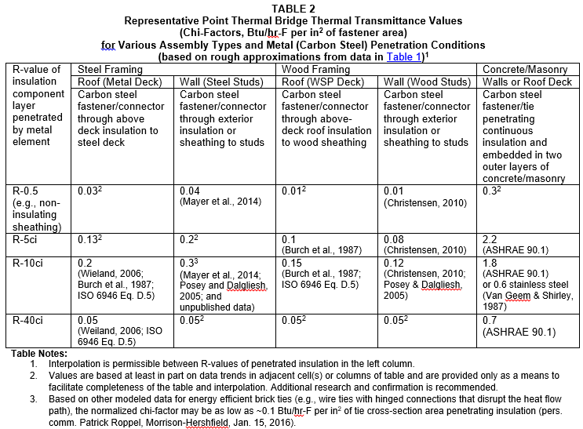
Example Design Data
(Chi-factors for metal/fastener penetrations)
Source:
ABTG RR No. 1510-03

Slide 26
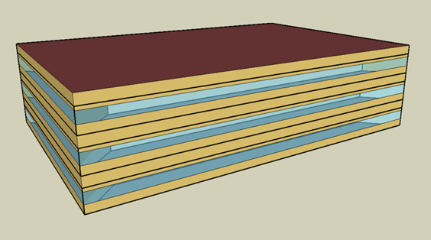
Design example (3-story office)
Structure: Steel Frame Walls with Concrete Slab Floors
CASE 1: No Thermal Bridges (ideal) w/ R13 cavity insulation only
Overall Opaque Wall Thermal Performance
Opaque U-Value (BTU/hr ft^{2 o}F) | 0.124
Effective R-Value (hr ft^{2 o}F/BTU) | 8.1
Proposed Building Entries |  |  |  |  |  | Totals | 1769.1 | 100%
Transmittance Type | Transmittance Description | Area, Length or Amount Takeoff | Units | Transmittance Value | Units | Source Reference | Heat Flow (BTU/hr°F) | %Total Heat Flow
Clear Field | Opaque Wall Area (R13 cavity insulation only) | 14267.00 | ft² | 0.124 | BTU/ hr ft² °F | Enter Source Here | 1769.1 | 100%
All cases include metal stud clear field thermal bridges within assembly
CASE 2: No thermal bridges (ideal) w/ R13+10ci insulation per 90.1
Overall Opaque Wall Thermal Performance
Opaque U-Value (BTU/hr ft^{2 o}F) | 0.055
Effective R-Value (hr ft^{2 o}F/BTU) | 18.2
Proposed Building Entries |  |  |  |  |  | Totals | 784.7 | 100%
Transmittance Type | Transmittance Description | Area, Length or Amount Takeoff | Units | Transmittance Value | Units | Source Reference | Heat Flow (BTU/hr°F) | %Total Heat Flow
Clear Field | Opaque Wall Area (R13+10 per ASHRAE 90.1) | 14267.00 | ft² | 0.055 | BTU/ hr ft² °F | Enter Source Here | 784.7 | 100%
Case 2 mitigates the clear-field framing thermal bridges within the assembly.

Slide 27
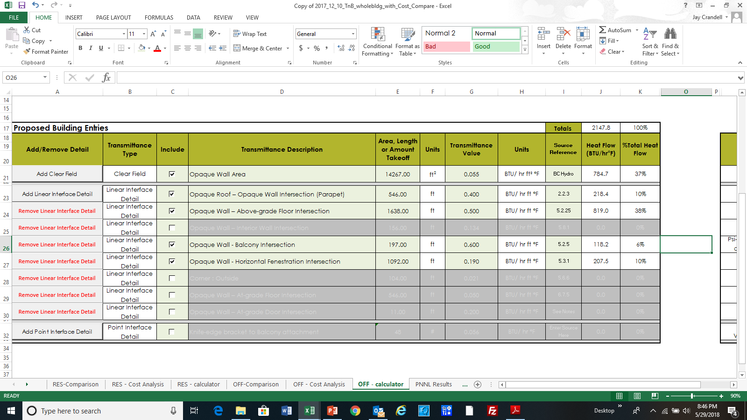
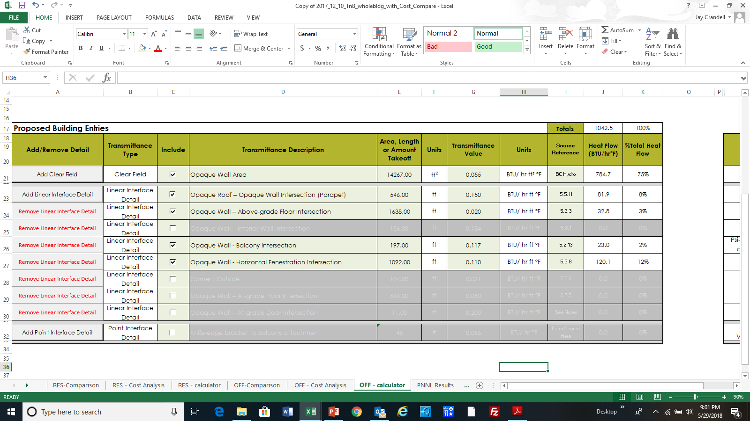
Design Example (3-story office building) – add effect of various linear thermal bridges in the building as constructed
CASE 3: R13+10 with Poor Thermal Bridging Details (64% of opaque wall heat flow)
Overall Opaque Wall Thermal Performance*
Opaque U-Value (BTU/hr ft^{2 o}F) | 0.151
Effective R-Value (hr ft^{2 o}F/BTU) | 6.6
* U-factor and effective R-value of opaque wall area is adjusted to include effect of various linear thermal bridges at wall-to-floor, -fenestration, and -roof assembly intersections
CASE 4: R13+10 with Very Efficient Thermal Bridging Details (now 25% of wall heat flow)
Overall Opaque Wall Thermal Performance*
Opaque U-Value (BTU/hr ft^{2 o}F) | 0.073
Effective R-Value (hr ft^{2 o}F/BTU) | 13.7

Slide 28
Status of ASHRAE 90.1 thermal bridging work
2005 to present - European (EU) countries address thermal bridging
2011 -- Canada NECB begins to address thermal bridging
2011 -- ASHRAE RP 1365 research report completed (Morrison Hershfield LTD)
2012 – ASHRAE 90.1 Thermal Bridging Task Group initiated within Envelope Subcommittee
2014 -- Building Envelope Thermal Bridging Guide completed (Morrison Hershfield LTD)
  Funded by BC Hydro Power Smart, Canadian Wood Council, Fortis BC, FPInnovations, Homeowner Protection Office of BC Housing
  Significantly expanded work of ASHRAE RP 1365
2014 – Initial draft of thermal bridging proposal for ASHRAE 90.1
2018 – Draft being readied for public review.

Slide 29
Content of ASHRAE 90.1 Thermal Bridging Draft Proposal
Definitions
Prescriptive structural/insulation detailing solutions
  Roof-wall intersections
  Wall-floor intersections
  Fenestration-wall intersection
  Shading devises/fins/awnings
  Large elements penetrating envelope
  Simplified trade-off of thermal bridging details for more insulation
Prescriptive provisions have exemptions (e.g., CZ 1-3 excluded) and many exceptions to give “practical” allowances and avoid “extreme” mitigation practices.

Slide 30
Content of ASHRAE 90.1 Thermal Bridging Draft Proposal
Not exhaustive; tends to focus on the “big” thermal bridges
Informative (conceptual) figures provided for each provision
Integrated into performance path to allow flexibility in addressing alternative thermal bridging details, solutions, or proprietary devices
  Computer energy modeling will need to catch up (ComCHECK, EnergyPlus, etc.) to efficiently enable and maximize effectiveness of addressing thermal bridges

Slide 31
Conclusion
Thermal bridging has generally been ignored and unregulated, except as they occur due to framing members within assemblies.
Unaccounted thermal bridging can account for 20-70% of heat flow through the building’s opaque envelope.
Reasonable efforts to use improved details to mitigate point and linear thermal bridges can significantly improve building envelope performance.
For buildings with significant types or quantities of thermal bridges, it is generally more beneficial to mitigate thermal bridges than to increase insulation amounts.
Several sources of data and design guidance are available to support appropriate consideration and mitigation of thermal bridges (see BC Hydro, ISO and others in Bibliography).
Energy codes and standards are changing to better address thermal bridging effects.

Slide 32
Bibliography
Morrison Hershfield Ltd. 2016. Building Envelope Thermal Bridging Guide, Version 1.1, Prepared for BC Hydro Power Smart, Canadian Wood Council, Fortis BC, FPInnovations, Homeowner Protection Office of BC Housing. https://www.bchydro.com/powersmart/business/programs/new-construction.html#thermal
Morrison Hershfield Ltd. 2012. “Thermal Performance of Building Envelope Details for Mid- and High-Rise Buildings.” ASHRAE Research Project RP-1365. Atlanta, GA: American Society of Heating, Refrigerating, and Air-Conditioning Engineers (ASHRAE). www.ashrae.org
ISO Standard 10211: 2007, Thermal Bridges in Building Construction – heat flows and surface temperature – Detailed calculations.
ISO Standard 14683: 2007, Thermal Bridges in Building Construction – Linear thermal transmittance (simplified methods and default Chi-factors).
AISC/SEI, Thermal Bridging Solutions: Minimizing Structural Steel’s Impact on Building Envelope Energy Transfer, A Supplement to Modern Steel Construction, March 2012, American Institute for Steel Construction (AISC) & Structural Engineering Institute (SEI). www.seisustainability.org, www.aisc.org/sustainability
USACE, “Development of Thermal Bridging Factors for Use in Energy Models,” ERDC/CERL TR-15-10, June 2015, U.S. Army Corp of Engineers, Engineer Research and Development Center, Construction Engineering Research Laboratory. https://erdc-library.erdc.dren.mil/xmlui/handle/11681/20209
Thermal Performance of Facades, 2012 AIA Upjohn Grant Research Initiative, Payette, Boston, MA, November 2014. https://www.payette.com/research/thermal-performance-of-facades/
Repetitive Metal Penetrations in Building Thermal Envelope Assemblies, ABTG Research Report No. 1510-03, Applied Building Technology Group LLC, 2016. www.appliedbuildingtech.com

